Slide 1
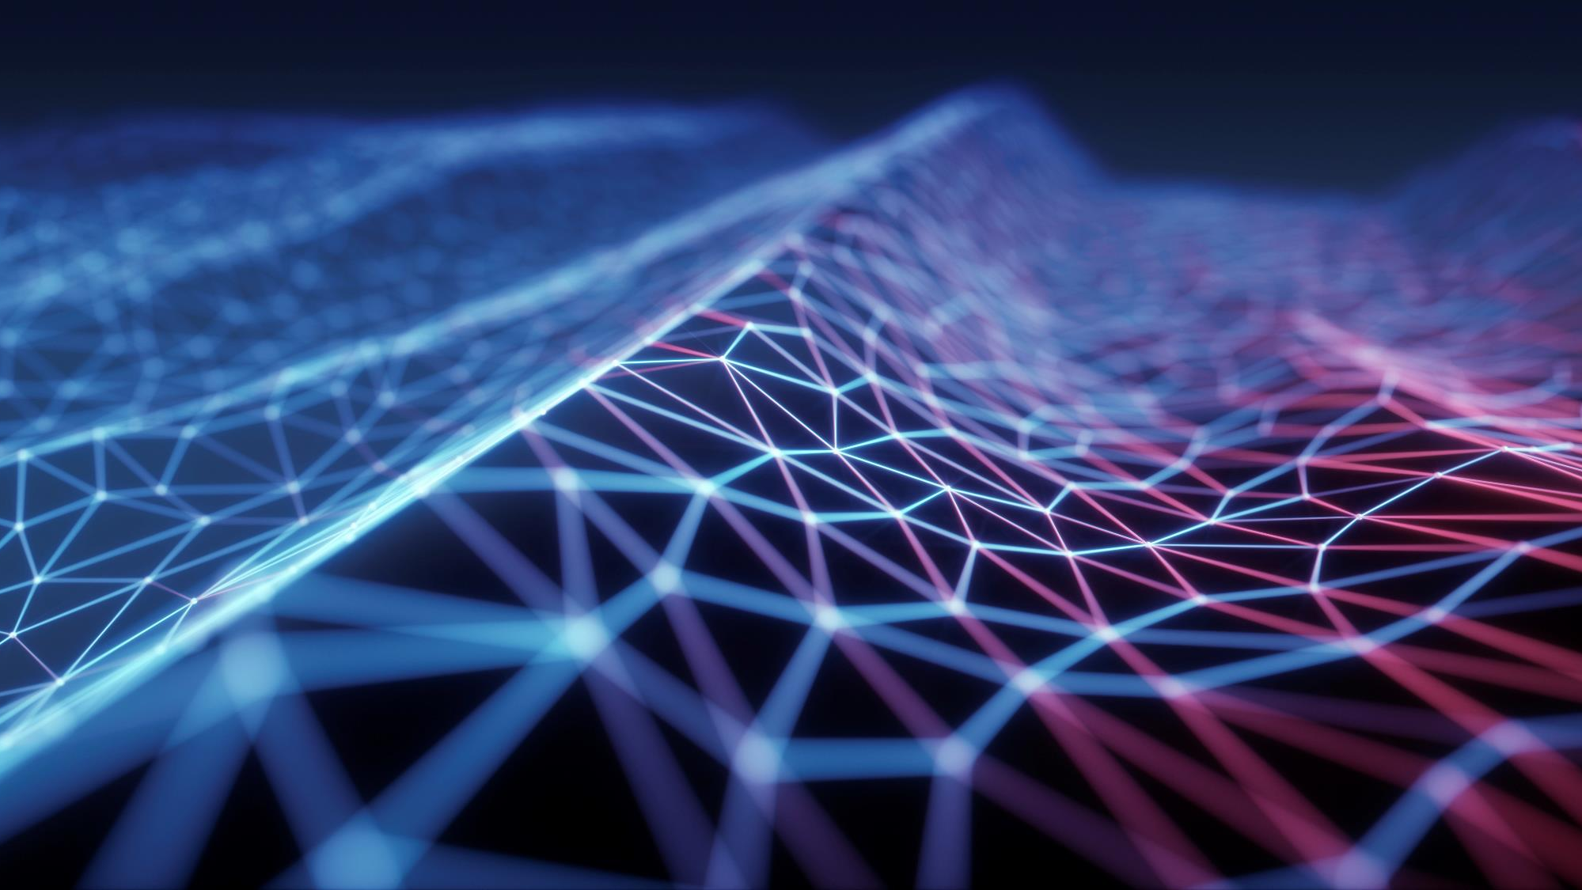
QUANTUM TOOLS FOR EARLY CANCER DETECTION
Prepared by: Vesela Krumova, madlen manolova
Fn: 201220014, 951220012
Subjects: Programming (kst), Business Informatic
Fdiba, technical university of sofia, sofia, bulgaria

Slide 2
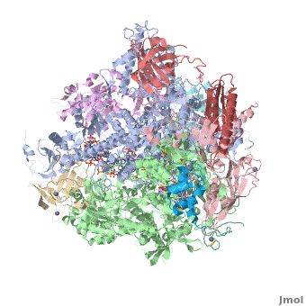


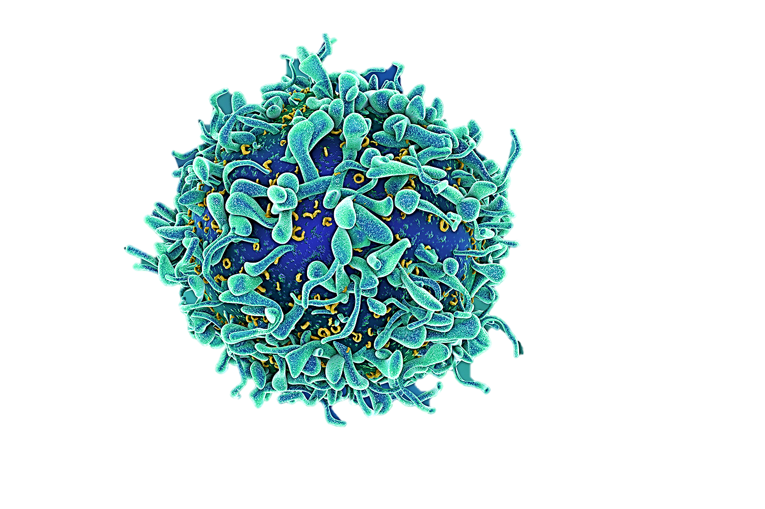

CONTENT
Meaning and application of quantum methods and techniques
Quantum technologies as an aid in the fight against cancer
Introduction
Quantum cytosensing via SERS for early detection of cancer
Variational Quantum Unsupervised Learning (VQUL)
SERS (Surface-enhanced Raman spectroscopy)
Quantum (cyto-)sensor
Hyperpolarization
More about quantum dots

Slide 3
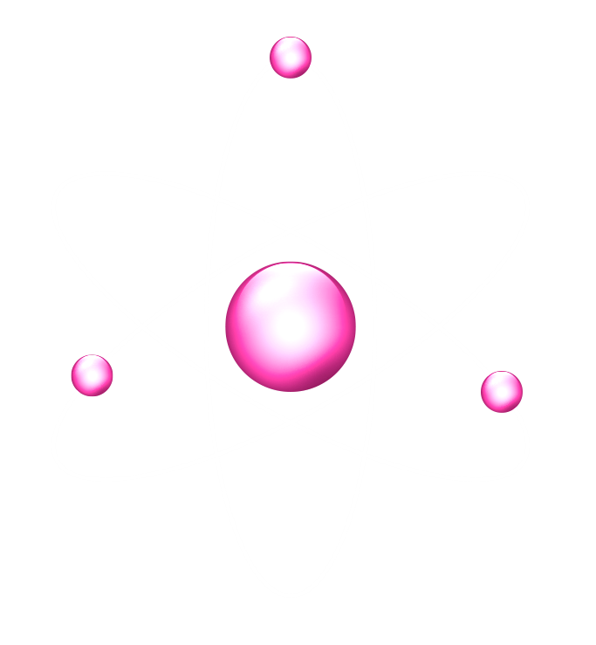
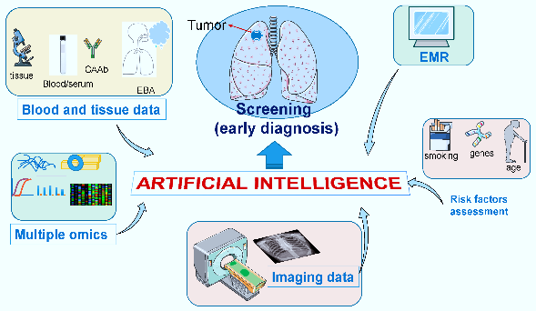
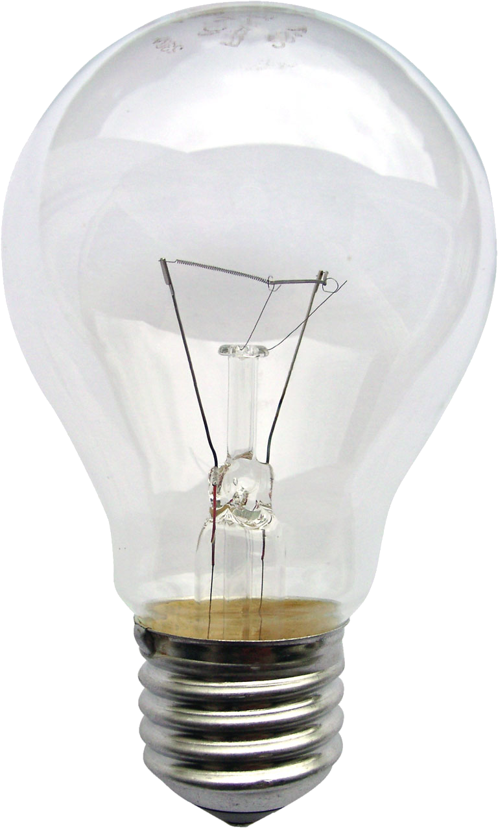
INTRODUCTION
Cancer
Quantum computing
complex disease that affects millions of people worldwide;
the second leading cause of death in the world in 2020;
traditional cancer detection methods – time-consuming and not always detect cancer in its early stages;
development of quantum tools for detecting cancer in treatable form;
creation of more advanced artificial intelligence algorithms;
ability to perform calculations much faster than classical computers;
identifying cancer biomarkers much more quickly than traditional methods;
different advances in quantum computing some of which are related to the treatment of diseases such as Alzheimer’s, dementia, cancer, etc.;
DIAGRAM 1: Artificial Intelligence tools [10]
3

Slide 4
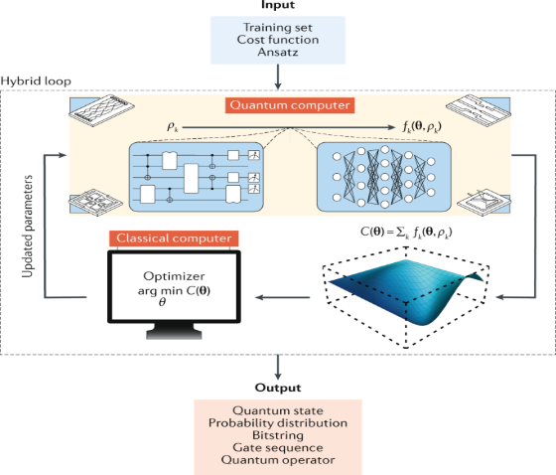
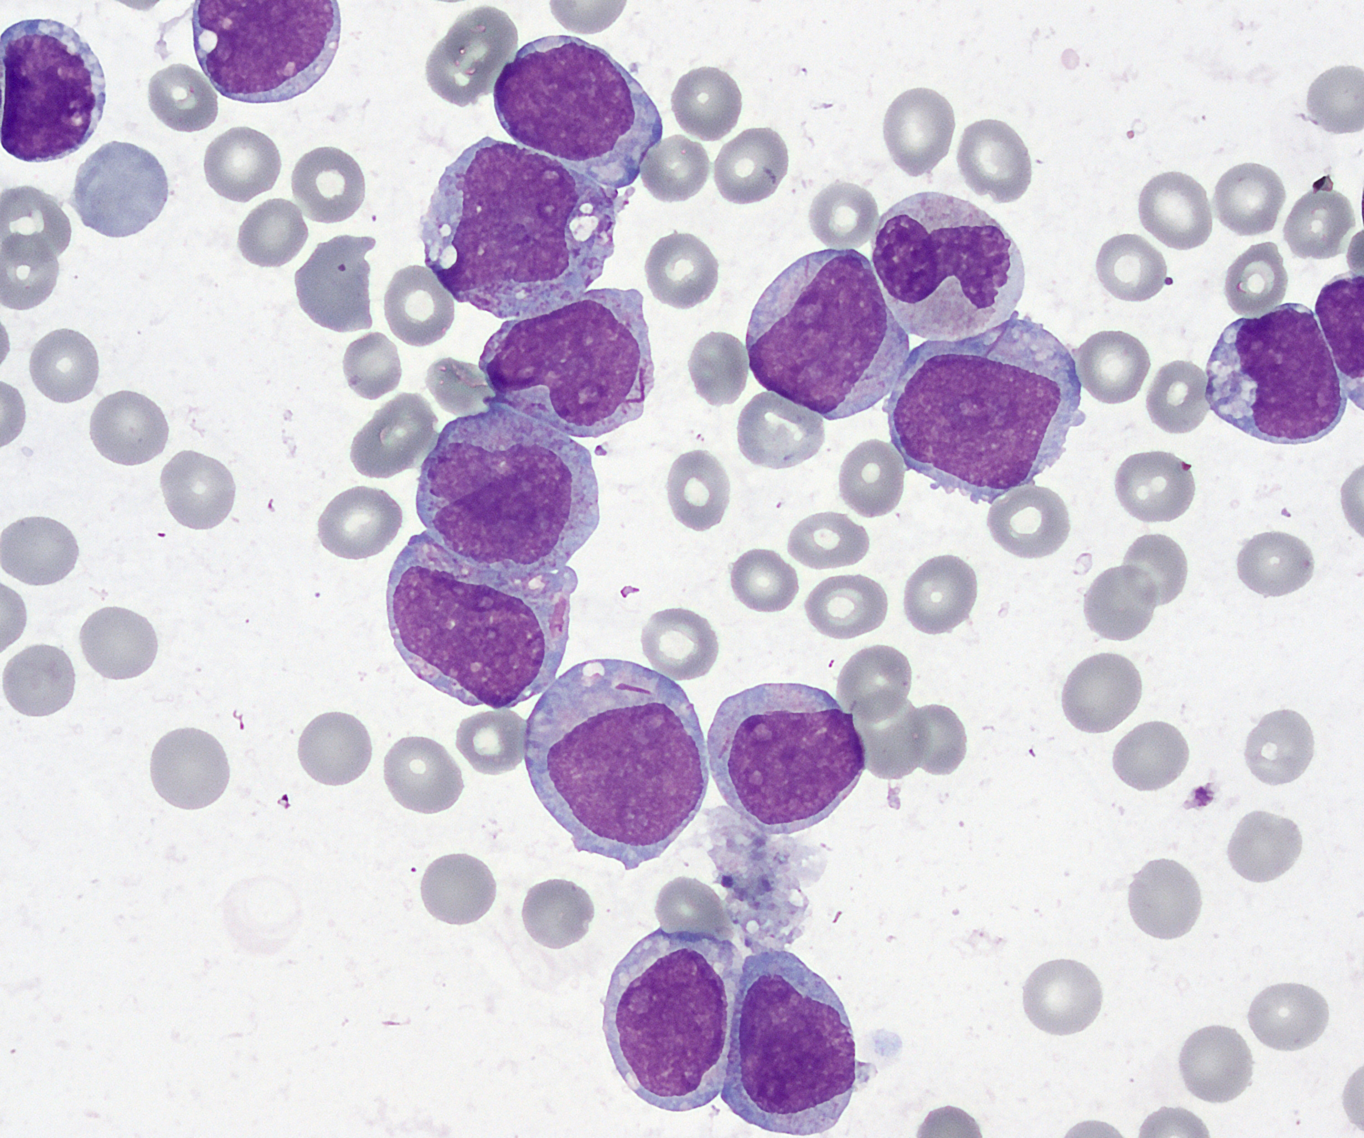
Variational Quantum Unsupervised Learning (VQUL)
developed from IBM researchers;
identify genetic mutations in cancer cells by analyzing large amounts of genomic data;
uses unsupervised machine learning technique;
analyze genomic data from patients with acute myeloid leukemia (AML) – type of blood cancer;
DIAGRAM 2: Variational quantum algorithms [11]

Slide 5
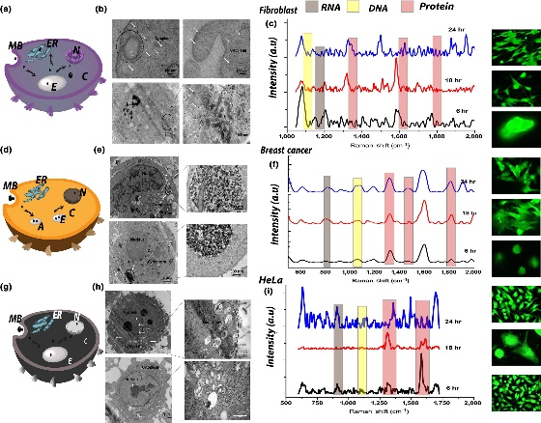
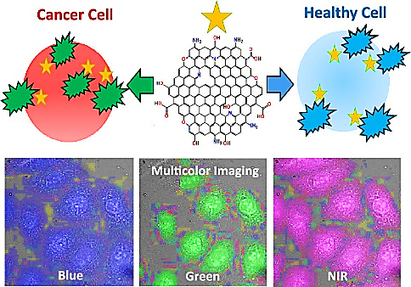
Quantum (cyto-)sensor
very small devices – the size of a sugar cube;
incredibly sensitive to changes in the physical state of molecules;
related to detecting biomarkers potentially to diagnose cancer at its earliest stages;
sensing the complex biomolecular processes occurring intracellularly to detect and differentiate cancerous cell attributes;
detecting cancer down to the single-cell level using quantum-cytosensing via SERS (Surface-enhanced Raman spectroscopy);
focus on reporting cancer-associated biomarkers and in vitro detection;
the SERS sensitivity of graphene quantum dots (GQDs);
DIAGRAM 3: Quantum cytosensor for early detection of cancer [5]
DIAGRAM 4: Doped Graphene Quantum Dots for Intracellular Multicolor Imaging and Cancer Detection [12]

Slide 6
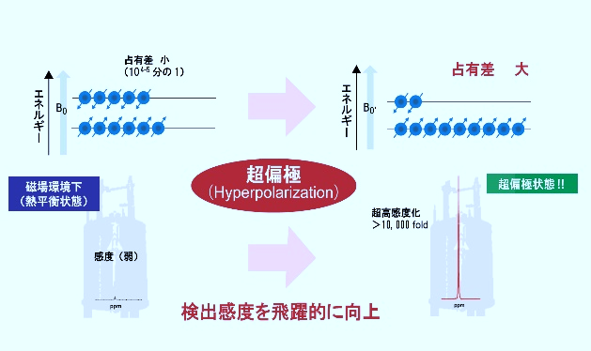
Hyperpolarization
DIAGRAM 5: Hyperpolarization [9]
the idea of the project MetaboliQS – represents a (MRI) method that provides information on the chemical state of tissue;
hyperpolarized magnetic resonance imaging looks at the tiny physics of cells and molecules by using selective biomarker molecules;
advantages of quantum sensors made with diamonds and how contribute to the course of hyperpolarization;
the future development of MRI scanners;
Small difference
(10⁴⁻⁵ fold)
Large difference
energy
energy
under magnetic field
(thermal equilibrium state)
Hyperpolarized state
Ultra high density
Density-weak
improved detection sensitivity

Slide 7
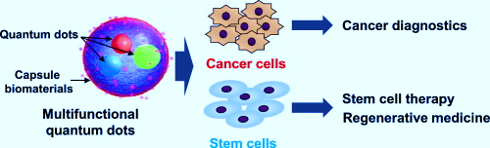
More about quantum dots
semiconductor nanocrystals structures;
applications of quantum dots;
the use of QDs as fluorescent probes in cancer cells lines;
their biocompatibility;
tumor biomarkers – critical for the detection and diagnosis of early – stage cancer;
GQDs – designed to prevent tumor development by destroying the DNA of cancer cells;
the main uses of QDs in cancer therapy;
DIAGRAM 6: Multifunctional quantum dots-based cancer diagnostics and stem cell therapeutics for regenerative medicine [13]

Slide 8
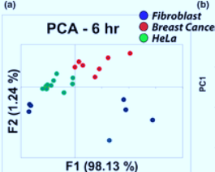
Quantum cytosensing via SERS for early detection of cancer
quantum cytosensor with a size of 2,5nm – reaches the nuclear membrane without affecting the cell structures;
the role of the endocytosis;
apoptosis – process of self – destruction;
increased levels of protein content;
Raman map image – Renishaw inVia confocal Raman microscope;
provided by “Medical Devices & Sensors”;
The main method used for analysis – clustering;
differentiation of cells, based on machine learning and graphene quantum dots representing a quantum cytosensor;
results – with reliability of over 90%;
DIAGRAM 7: Comparison of cancerous and non-cancerous cells through SERS spectra [5]

Slide 9

References
[1] World Health Organization. (2022, February 3). Cancer. Retrieved from: https://www.who.int/news-room/fact-sheets/detail/cancer, (accessed May 2023).
[2] Devopedia. “Quantum Computing”. Version 9. (2021, February 11). Retrieved from: https://devopedia.org/quantum-computing, (accessed April 2023).
[3] ETKHO, Hospital engineering. (2022, February 18). The future of quantum technology applied to medicine. Retrieved from: https://www.etkho.com/en/the-future-of-quantum-technology-applied-to-medicine/, (accessed May 2023).
[4] Jonathan O'callaghan. (2019, June 24). Quantum technology could revolutionise the detection and treatment of diseases. Horizon. Retrieved from: https://ec.europa.eu/research-and-innovation/en/horizon-magazine/quantum-technology-could-revolutionise-detection-and-treatment-diseases, (accessed May 2023).
[5] Swarna Ganesh, Krishnan Venkatakrishnan, Bo Tan. (2019, December 29). Quantum cytosensor for early detection of cancer. Retrieved from: https://onlinelibrary.wiley.com/doi/full/10.1002/mds3.10058, (accessed May 2023).
[6] MetaboliQs. (2018, October 29). A breakthrough in cardiac metabolic MR imaging. Retrieved from: https://www.metaboliqs.eu/en/news-events/MetaboliQs_Kick-off.html, (accessed May 2023).
[7] Aleksandra Zajac, Dansheng Song, Wei Qian, Tatyana Zhukov. (2007, March 5). Protein microarrays and quantum dot probes for early cancer detection. Retrieved from: https://www.sciencedirect.com/science/article/abs/pii/S0927776507001129, (accessed May 2023).
[8] Front. Mater. (2022, January 10). Quantum Dots: An Emerging Approach for Cancer Therapy. Retrieved from: https://www.frontiersin.org/articles/10.3389/fmats.2021.798440/full, (accessed May 2023).
[9] National Institutes for Quantum Science and Technology. (2023, April 1). Quantum Hyperpolarized MRI Team. Retrieved from: https://www.qst.go.jp/site/qls-english/44749.html, (accessed May 2023).
[10] J. Luis Espinoza, Le Thanh Dong. (2020, November 27). Artificial Intelligence Tools for Refining Lung Cancer Screening. Retrieved from: https://www.mdpi.com/2077-0383/9/12/3860, (accessed May 2023).
[11] Nature Reviews Physics. (2021, August 12). Variational quantum algorithms. Retrieved from: https://www.nature.com/articles/s42254-021-00348-9, (accessed May 2023).
[12] Elizabeth Campbell, Md. Tanvir Hasan, Roberto Gonzalez Rodriguez. (2019, July 15). Doped Graphene Quantum Dots for Intracellular Multicolor Imaging and Cancer Detection. Retrieved from: https://pubs.acs.org/doi/10.1021/acsbiomaterials.9b00603, (accessed May 2023).
[13] Daisuke Onoshima, Hiroshi Yukawa, Yoshinobu Baba. (2015, December 1). Multifunctional quantum dots-based cancer diagnostics and stem cell therapeutics for regenerative medicine. Retrieved from: https://www.sciencedirect.com/science/article/abs/pii/S0169409X15001945, (accessed May 2023).
9

Slide 10
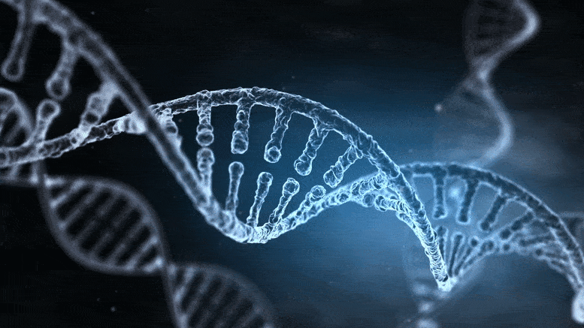
Thank you for your attention!!!
CONTACTS: vesela.krumova@fdiba.tu-sofia.bg, madlen.manolova@fdiba.tu-sofia.bg

